Slide 1
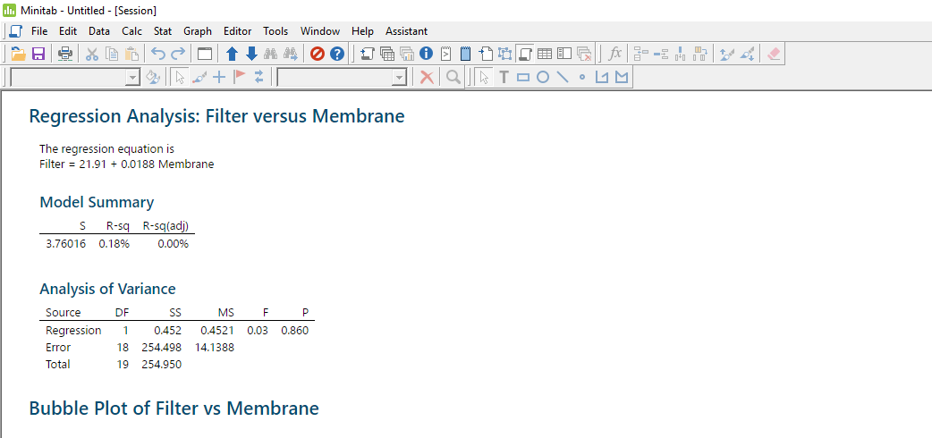
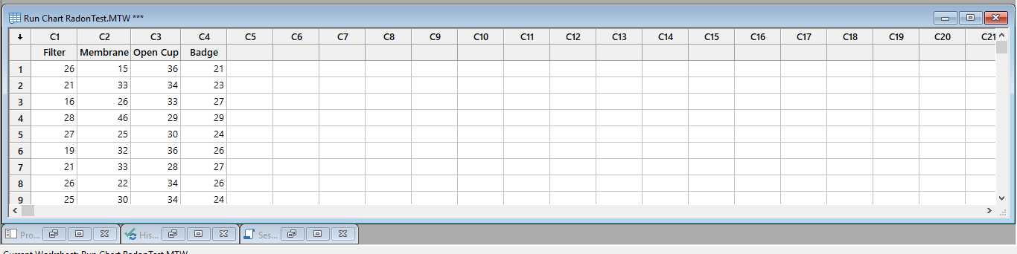
Military Institute of Science And Technology
DATAMINING USING MINITAB
Roll:201636015
Summary
Powerful tools and vivid graphs bring statistics to life. Minitab Express provides all the tools you need to teach introductory statistics, including Probability Distributions, Summary Statistics, Hypothesis Tests, Resampling, Regression, ANOVA, Time Series, and Control Charts.

